Slide 1
Secure Web Programming
Lecture 6 State management & HTTP header
Amanda.Lunt@utas.edu.au
Soonja.Yeom@utas.edu.au

Slide 2
Topics
Secure Web Programming
Week13
Review
Basic Web Programming
Web Security
Adv. Web Programming
Fundamentals – protocol, CS model, etc.
HTTP Protocols, Storage
Advanced Web Applications
Human Computer Interaction with Web Page Design
Security Issues and Technologies
Session management
Client-side Scripting Language and Document Object Model
Secure Programming and Users
Common Gateway Interface
Server-side Scripting Language and Privilege configuration
Encryption and Authentication
Advanced Security Issues

Slide 3
Last lecture, we learned…
SQL Query
Dealing with errors
Storing data in secure way
Online shopping mall Process

Slide 4
Review: DB_CONN.php
It is not efficient to write the codes to connect database every time
it is useful to make a php file for database connection and use include() function whenever you use database.
[ db_conn.php ]

Slide 5
Review: Select rows from table

Slide 6
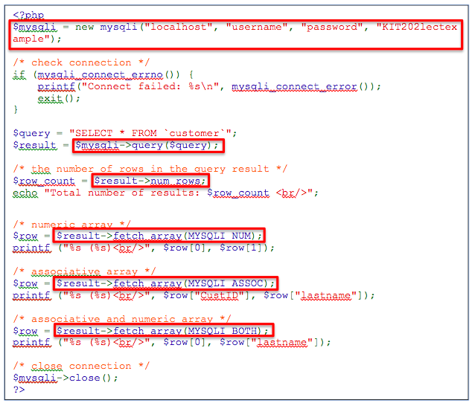
PHP – MySQL (example)

Slide 7
Today’s Lecture
State Management
Session
Cookie
Header (HTTP Header)

Slide 8

State Management
How does the server know whether you have logged in or not?

Slide 9
State Management
HTTP is stateless protocol.
No information about the client is stored by the server.
Each http transaction is independent of any other.
The Downside of Statelessness
The server has no knowledge of which pages a client has already seen.
If pages require authentication, how/ where do you record that a user has logged in?
If a user is "shopping", how/where do you record what is currently in their shopping basket?

Slide 10
State Management
Client-side storage
Server writes the information to the client and client sends the information back to the server.
Large amounts of session information will mean that large amounts of information are sent back and forth between server and client.
Server-side storage
Client sends an “identifier” to select the correct session information of this client.
PHP supports for session maintenance.

Slide 11
State Management
How does the server know whether you have logged in or not?
Session? Cookie?

Slide 12
Session
A Session
A sequence of service requests (and responses) between a specific web browser and a specific web server.
allows the possibility of sharing information between one request and another
Session Information Maintenance
Using form/HTML
Using URL
Using Cookie

Slide 13
Session in PHP
How to exchange the session ID between server and client
Use session functions:
session id is used to identify relevant session information
session_start() uses cookie between server and clients
session information is stored on server side

Slide 14
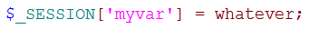
Session in PHP
Server-side storage of state information
$_SESSION
a superglobal variable
The programmer can use it to store information.
PHP session handling
start a session
set the session variables
use the session variables as required
unset the session variables and destroy the session

Slide 15
Starting a Session
to start a session, call session_start()
If a session exists (received the session ID as part of the request), PHP will load the session variables.
If there is no existing session, PHP will create one.
generates a session ID and sends it along with the session name to the client
session_id() returns the session ID.
tips
call session_start(); at the beginning for all scripts that use sessions
not just the script that creates the session
session_start() may generate headers, so call it before any HTML has been generated

Slide 16
Storing and accessing a session variables
Can store / use / change values in $_SESSION
generally request messages will provide the information that is then stored (or processed and then stored) in $_SESSION
this information can then be used by any pages in the session

Slide 17
End of Session
Unregistering / Destroying
to unregister a session variable, call unset($_SESSION[“variable_name”]);
variable will no longer be stored in the session file, and will be unavailable to future scripts
to destroy the session, call session_destroy();
deletes the session file
typically done at "user logout"

Slide 18
Cookies in PHP
How to exchange the session ID between server and client
Cookies:
small pieces of information that the server can store in the browser
the cookie name
an expiry date and time
a path and a domain
a secure flag

Slide 19
Cookies in PHP
Server to Client
cookies are sent from the server to the client in the HTTP response headers
Set-Cookie: name=value; expires=date; path=path; domain=domain; secure
Client to Server
when a browser requests a page from a server, it checks its cookie store for any cookie whose
domain matches the server's domain
path matches the path of the page being retrieved from the server
all matching cookies are sent to the server as part of the HTTP request headers

Slide 20
Cookies in PHP
Creating cookies
setcookie(name, value, [expire, path, domain, secure]);
name, value, path and domain are strings
expire and secure are integers
expire is specified in seconds since the Unix epoch (January 1, 1970)
Accessing information in cookies
The superglobal $_COOKIE holds all of the cookies that have been received as part of the current request.
Deleting cookies
set another cookie with exactly the same name without value or an expiry time that has passed

Slide 21
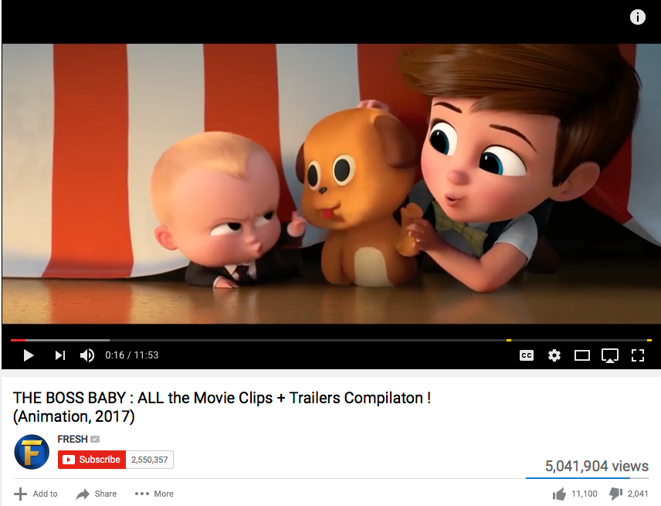
Counting views

Slide 22
Counting views without any state management
What if user refresh the web page?
<?php
$fp = fopen("counter.txt", "r");
$size = filesize("counter.txt");
$count = fread($fp, $size);
fclose($fp);
$count = $count + 1;
$fp = fopen("counter.txt", "w");
fwrite($fp, $count);
echo "$count views";
?>

Slide 23
Counting views with Sessions
<?php
session_start();
$fp = fopen("counter.txt", "r");
$size = filesize("counter.txt");
$count = fread($fp, $size);
fclose($fp);
if(!isset($_SESSION['count'])){
$_SESSION['count']= "set";
$count = $count + 1;
$fp = fopen(”sessioncounter.txt", "w");
fwrite($fp, $count);
}
echo "$count views";
?>
What if user closes the browser and reopens the web page?
Using the session for counting may cause overloading

Slide 24
Counting views with Cookies
<?php
$fp = fopen(”cookiecounter.txt", "r");
$size = filesize(”cookiecounter.txt");
$count = fread($fp, $size);
fclose($fp);
$ip = $_SERVER['REMOTE_ADDR'];
if($ip!='' && $_COOKIE[ip]!=$ip){
$count = $count + 1;
$fp = fopen(”cookiecounter.txt", "w");
fwrite($fp, $count);
SetCookie("ip",$ip , time()+60*60*24);
}
echo "$count views";
?>
As cookies are stored in user’s browser, they may be edited by user/third party.
This may cause a security problem when the cookies are used for authentication.

Slide 25
HTTP (HyperText Transfer Protocol)
Again,
It is stateless
Each transaction is not related to any other transaction
Sever maintains no “memory” of client after close
HTTP is lightweight
open connection (not part of HTTP but TCP/IP)
request (client->server)
response (server->client)
close connection (not part of HTTP but TCP/IP)

Slide 26


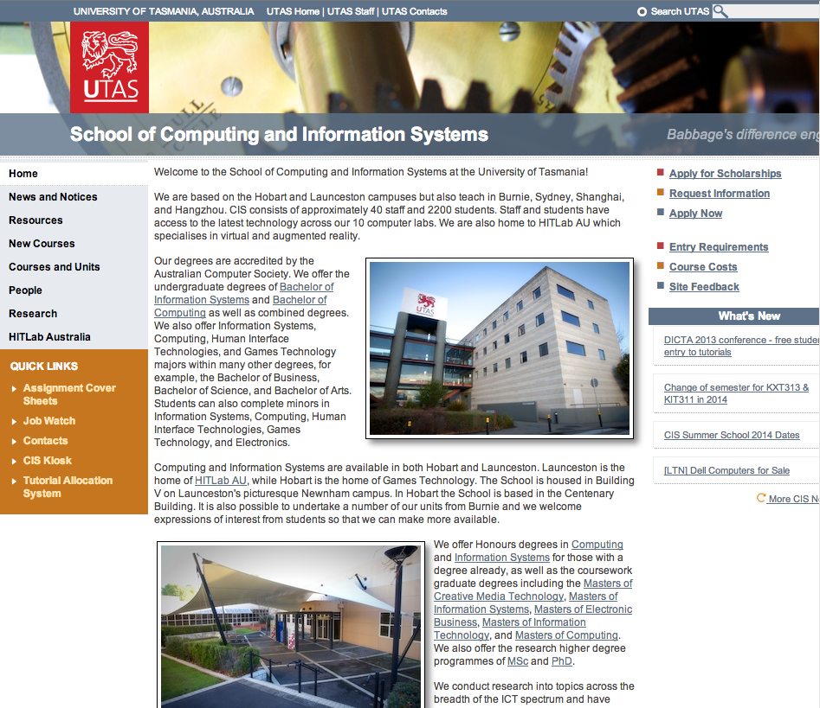
Serving Web pages (Hypertext pages) using HTTP
http://www.cis.utas.edu.au
HTTP request message
Request: “Could you send me the content?”
Response: “Here you go”
HTTP Response message
Web Client
CIS Host
Web Servers

Slide 27
HTTP messages – Initial Line
Text messages with a set format –contain all of the communication between client and server
Request message (sent by client)
Response message (sent by server)
Message structure is same for both request and response.
Request message
Response message
Called the request line – 3 parts
Method (e.g. GET, POST)
Uri of request resource
HTTP version being used
Initial Line
Called the status line – 3 parts
HTTP version
Response code
Response phrase
Contain information that allows the client to:
Provide information about itself to the server
Give additional details about the nature of the request that the client is making
Allow the client to have greater control over how its request is proceed and how a response is returned by the server or intermediary
Headers
Contain information about such things as:
the media type of the content sent to the recipient
a new URL that the server is instructing the client to use in place of the one the client initially requested
cookies that the client should store
Blank Line
May contain data that has been submitted from a form
Optional Contents
The actual contents of the resource requested (e.g. the xhtml code)

Slide 28
Initial Line (Request): General
Format
In HTTP1.0,
Simple requests : Use initial line without others
Full requests : Use full format
<optional content> is still option
Example
GET /main/first.html HTTP/1.0
Method LocalPath ProtocolVersion <CRLF>

Slide 29
Initial Line (Request): Method
GET
most common method, used for almost all document retrieval. It is used to request the content from the server.
POST
for sending complex data (eg., from forms) from the client to the server to be processed by server side.
Requested URI is usually a program such as CGI programs or scripts
GET can be used to submit form data but data is appended to the request URI.

Slide 30
Initial Line (Request): Method
HEAD
like GET, but the server should not send the <optional contents>
It can check the status without getting actual content.
It can check if the content is modified
PUT
for uploading files from clients to servers
Some web authoring tools use this method to maintain web pages directly from the client
It normally requires the authentication to perform this method.
It replaces the requested URL with <optional content>
DELETE
delete the URI on the server
The server can override this request
CHECKOUT
like GET, but also locks the object from updates (so the object can be edited by someone)
CHECKIN
like PUT, but releases the lock on the object - used when an object has been edited and the new version is now being uploaded

Slide 31
Initial Line (Response): Examples
format
the ProtocolVersion identifies which version of HTTP the client is using
HTTP/1.0 or HTTP/1.1
indicates the success or validity of the request
1xx : information message only
2xx : success of request
3xx : redirects
4xx : error on the client’s part
5xx : error on the server’s part
Reason
Describing the status code
ProtocolVersion StatusCode Reason<CRLF>

Slide 32
Initial Line (Response): Examples
HTTP/1.0 200 OK: request filled
HTTP/1.0 301 Moved Permanently : (to a new location)
HTTP/1.0 400 Bad Request
HTTP/1.0 401 Unauthorised
HTTP/1.0 403 Forbidden
HTTP/1.0 404 Not Found
HTTP/1.0 500 Server Error
HTTP/1.1 100 Continue

Slide 33
HTTP messages - Headers
Text messages with a set format –contain all of the communication between client and server
Request message (sent by client)
Response message (sent by server)
Message structure is same for both request and response.
Request message
Response message
Called the request line – 3 parts
Method (e.g. GET, POST)
Uri of request resource
HTTP version being used
Initial Line
Called the status line – 3 parts
HTTP version
Response code
Response phrase
Contain information that allows the client to:
Provide information about itself to the server
Give additional details about the nature of the request that the client is making
Allow the client to have greater control over how its request is proceed and how a response is returned by the server or intermediary
Headers
Contain information about such things as:
the media type of the content sent to the recipient
a new URL that the server is instructing the client to use in place of the one the client initially requested
cookies that the client should store
Blank Line
May contain data that has been submitted from a form
Optional Contents
The actual contents of the resource requested (e.g. the html code)

Slide 34
Headers
Format
Header-Name is not case sensitive
Multiple spaces or tabs between “:” and value
16 Headers in HTTP/1.0 and 46 Headers in HTTP/1.1
Applications can define their own headers.
Lines beginning with space or tab are part of the previous header line
Header1: value1, value2
Header2: value1,
value2
Header-Name: value<CRLF>
Both are same

Slide 35
Headers
Common headers
Headers appear in both request and response message
Request headers (Proxy and Server)
Headers appear in a request message
Response headers (Proxy and Server)
Headers appear in a response message
Other headers
Headers that are not defined in the specification

Slide 36
Headers in Request
USER-AGENT:
text that describes the client
servers could use this to tailor content to specific client
also useful for statistical and logging purposes
REFERER:
allows the client to specify where the URI in the request was obtained (from what web page)
permits the server to log which pages link to it
allows bad links to be traced for maintenance

Slide 37
Headers in Response
Server:
Identifies the server software
Value format is usually Program-name/x.xx.
User-Agent header in request is analogous to this and the value format is normally similar.
Last-Modified:
gives the modification date of returning document.
Use Greenwich Mean Time
Last-Modified: Fri, 31 Dec 1999 23:59:59 GMT
Possible to use as caching information

Slide 38
HTTP Headers with PHP
HTTP transactions contains request and response headers
PHP scripts can send HTTP response headers to the browser
using the header() function
Restrictions
header() must be called before any other output is sent to the browser
ie., before PHP echo or print statements
before HTML output

Slide 39
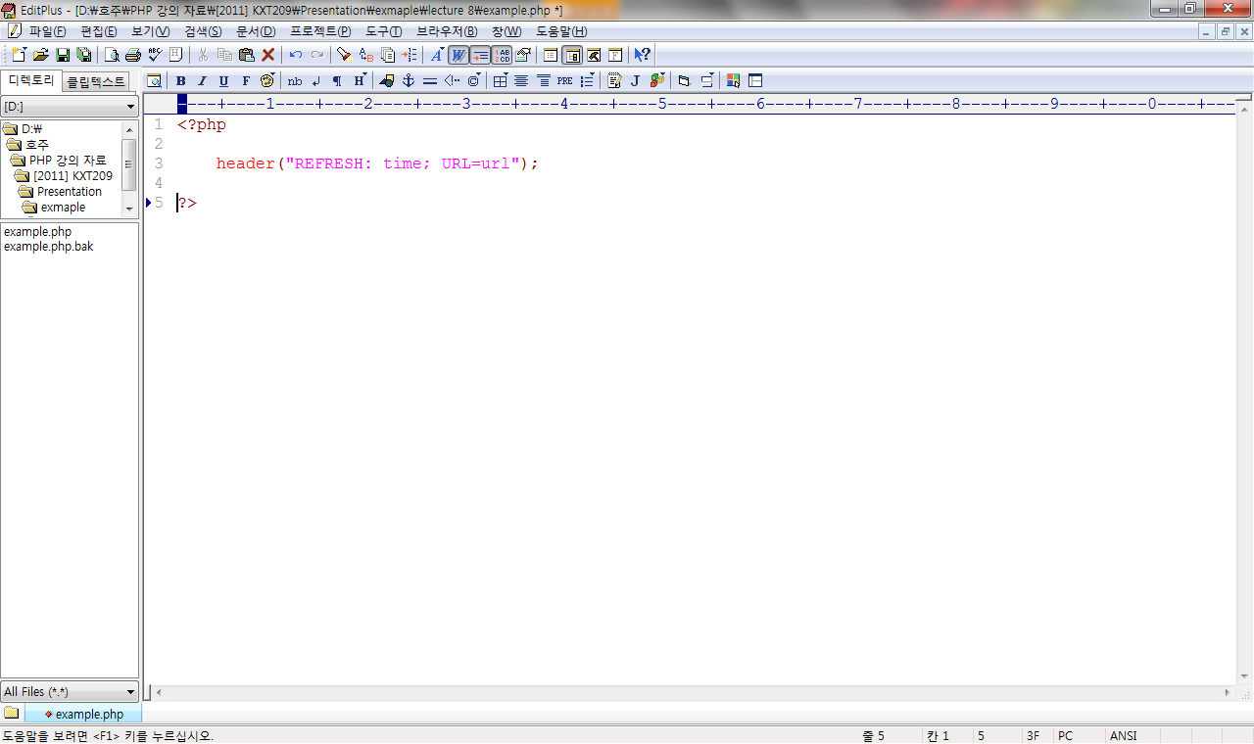
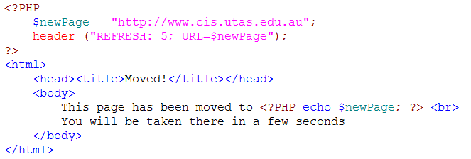
Refresh Header
the refresh header forces the browser to load a new page after a set period of time
time is specified in seconds
URL may be on this site, or another site
example

Slide 40
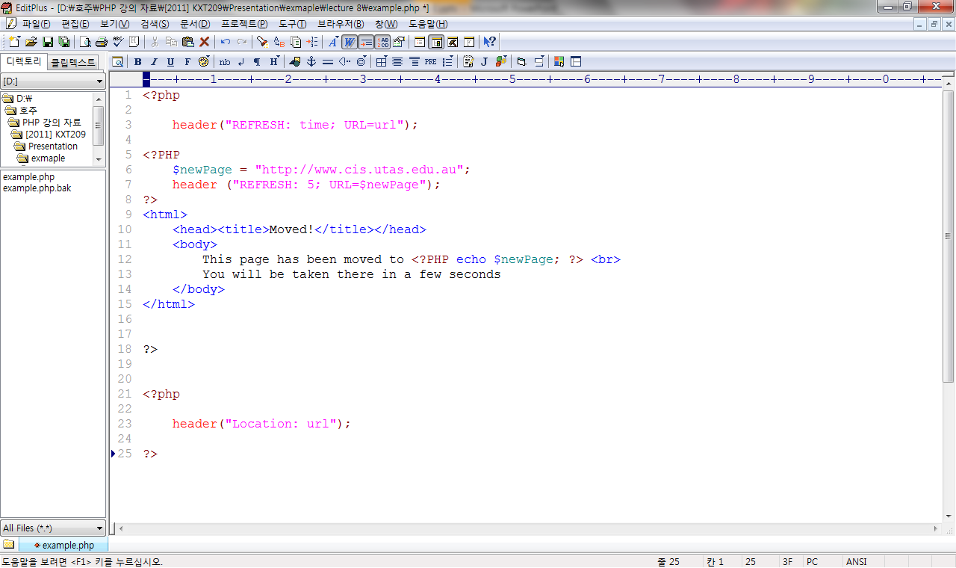
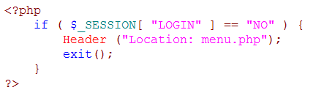
Location Header
the location header forces the browser to go to a new page immediately
compared to refresh
you can use HTML and other content on pages that are to be refreshed
no point using any HTML content on pages redirected with a location header
example

Slide 41
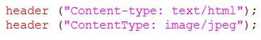
Content-Type Headers
the content-type header allows you to send non-html output to the client
eg., an image, multimedia content, or plain text
if you don't send a content-type header, PHP will automatically generate
Content-type: text/html
content-type header example

Slide 42
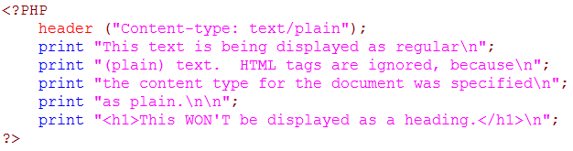
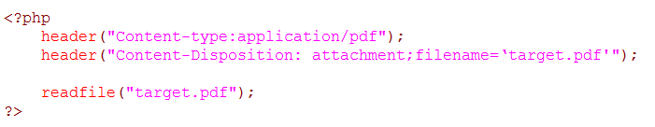
Content-Type Headers

Slide 43
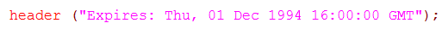
Expires Headers
the expires header indicates when the content being sent will be out of date
the date is specified according to RFC-1123
the cache problem
some browsers cache content sent them
on subsequent visits to the same URL, the browser will display the cached content
(for performance improvement)
the expires header tells the browser when it is no longer safe to use the cached copy
ie., when it should request the document from the server again

Slide 44
HTTP messages – Optional Contents
Text messages with a set format –contain all of the communication between client and server
Request message (sent by client)
Response message (sent by server)
Message structure is same for both request and response.
Request message
Response message
Called the request line – 3 parts
Method (e.g. GET, POST)
Uri of request resource
HTTP version being used
Initial Line
Called the status line – 3 parts
HTTP version
Response code
Response phrase
Contain information that allows the client to:
Provide information about itself to the server
Give additional details about the nature of the request that the client is making
Allow the client to have greater control over how its request is proceed and how a response is returned by the server or intermediary
Headers
Contain information about such things as:
the media type of the content sent to the recipient
a new URL that the server is instructing the client to use in place of the one the client initially requested
cookies that the client should store
Blank Line
May contain data that has been submitted from a form
Optional Contents
The actual contents of the resource requested (e.g. the html code)

Slide 45
Optional Content
In request
typically this is used to hold form data with the POST method
also used for content with PUT and CHECKIN methods
In response
This contains the requested resource by the client
Content-Type and Content-Length are related headers.

Slide 46
Header with Optional Content
CONTENT-TYPE:
the MIME type is used
specifies type of optional content
text/html and text/plain are common
image/gif, image/jpeg, etc.
Often given by the server side programs
Server has its own strategy to generate for default type.
CONTENT-LENGTH:
indicates that optional content is in a binary format
specifies the number of bytes of data
Content-Base, Content-Encoding, Content-Language, Content-Location, Content-MD5, Content-Range

Slide 47
Thank you
Any Questions

